Slide 1
GROUP 21
Design phase – Application Logic

Slide 2
Use Cases
A use case refers to a usage scenario for a piece of software. As previously stated, Stu-link is an interactive software platform that allows a students and lecturers to perform several functions, these include:
Students and lecturers checking statistics of performances of students who previously took a certain module.
Lecturers communicating to students about the availability of the forth-coming class
Students and lecturers checking a time-table organized to a specific module
Students applying for accommodation through a form

Slide 3
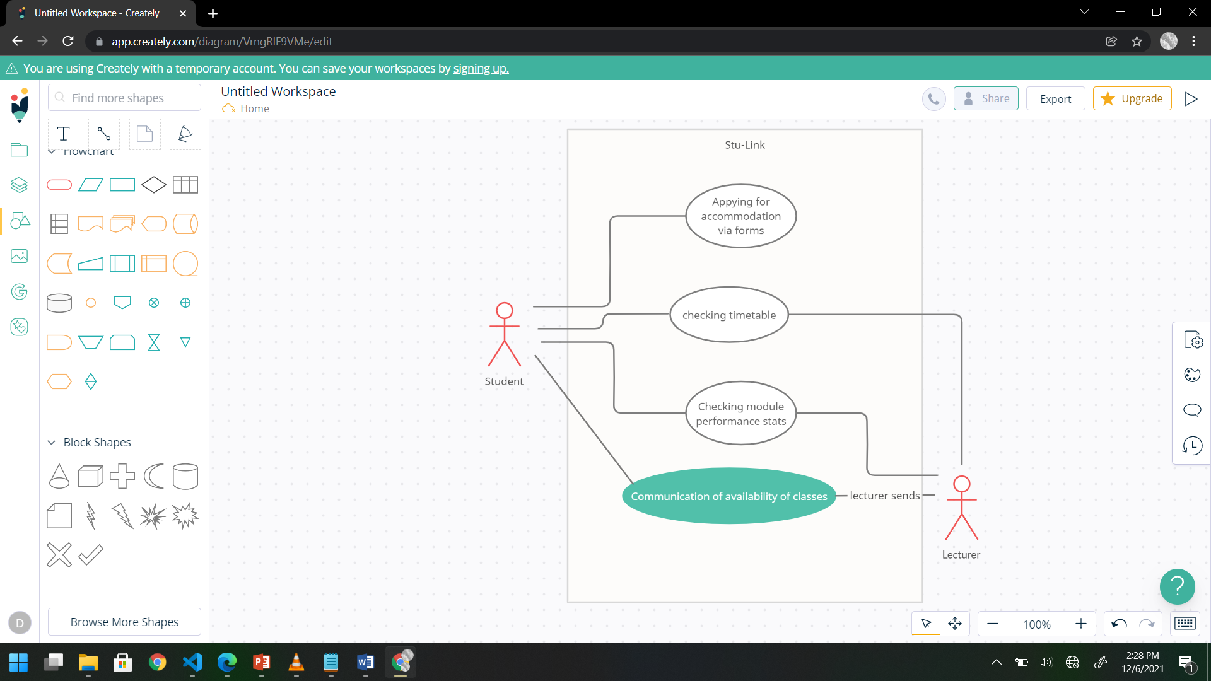
Use Case Diagram

Slide 4
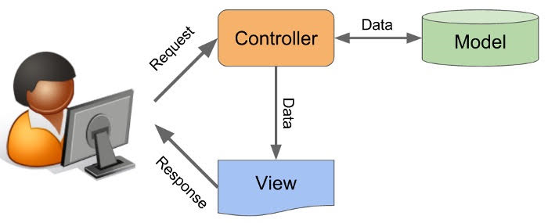
Application logic architecture
The Model-View-Controller
For Stu-link we at Group 20 have decide to adopt the model-view-controller architecture to structure our application logic. It contains separate application logic modules that each perform a different function.
By structuring the application like this, it allows us to work on one part of the programming without actually affecting the other parts.

Slide 5
Application logic architecture
More About the MVC architecture
Controller:
This acts as interface between the model and the view. This processes business logic such as requests from clients. It uses the model to manipulate data and interacts with the view component to produce the final product
Model:
This is concerned with all the data-related logic. Objects retrieve and process client data and returns a response.
View:
This is concerned with the presentation of data. This can be in the form of HTML and the business data that is returned by the model.

Slide 6
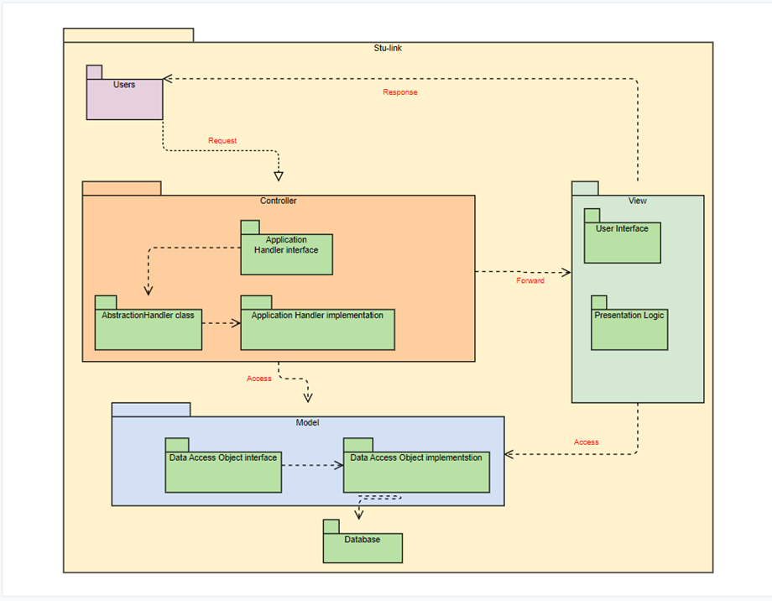
Application logic architecture – MVC Diagram

Slide 7
Use-case applied with MVC
Based on use case scenario 1
Client sends a request to the controller. In our case a student or lecturer requests to see statistics on student performance.
The controller specifies the action of the request and looks up for a class for the action. In this case, the action is to retrieve data on the student’s past performances. The class to implement this is a subclass of the Abstract Handler class
The controller creates an instance of a class and invokes a method based on that class. In this case the instance maybe how previous students taking COMP-111 performed, the right method is invoked to return the instance
The instance processes the request. The request is forwarded to the Stu-link page
Th Stu-link page gets an instance of the Model class to invoke a method to perform an action
The page extracts data from the data base and returns it through the view component to the user

